Slide 1


ISWP PROJECT INTERNSHIP
MENTOR: Mr. VIJAYANT KUMAR
GUIDE : Mr. VINOD KUMAR
PRESENTED BY : KUNAL BHUSHAN VAIDYA

Slide 2
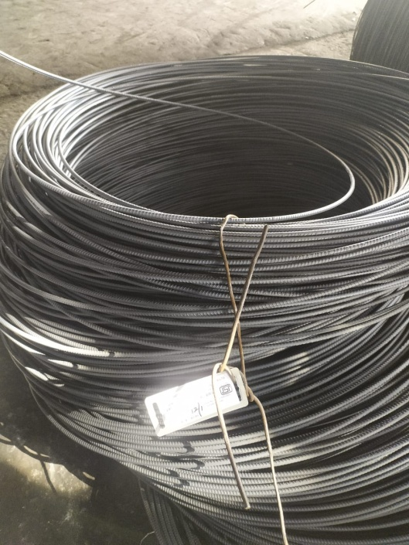
PROJECT TOPIC
Complete Study Of Rolling Practices And Recommend For Yield Improvement In Process and Scrap Reduction

Slide 3
Abstract
In a Industrial process which has huge production rate and demand therefore requires constant processing with very less time and opportunity for the improvisation it is very important for a metal forming process to be free from any defects that can lower its efficiency. Therefore for a production sector it is the biggest challenge to design its process with maximum yield and to avoid the majority of the losses which can be achieved by repetitive analysis and constant improvement of the process.

Slide 4
Acknowledgement
I would like to express my special thanks of gratitude to my guide Mr. Vinod Kumar sir for their able guidance and support in completing my project.
I would also like to extend my gratitude to Mr. Chandan Kumar Sir and Kabita mam for providing me all the facilities that was required. At last I would also like to thank our MD Mr. Neeraj Kant sir for giving me such wonderful opportunity.
Kunal Vaidya
IIT ISM Dhanbad

Slide 5
INTRODUCTION
This Project has been made to study the Rolling Processes. It includes concise information about the Rolling processes and Yield loss points some methods that can be applied to reduce the scrap.
For the Rod Mill section nearly 3% to 4% of the material is lost while processing. This loss even if looks smaller can add up to a huge number of lost material and capital.

Slide 6
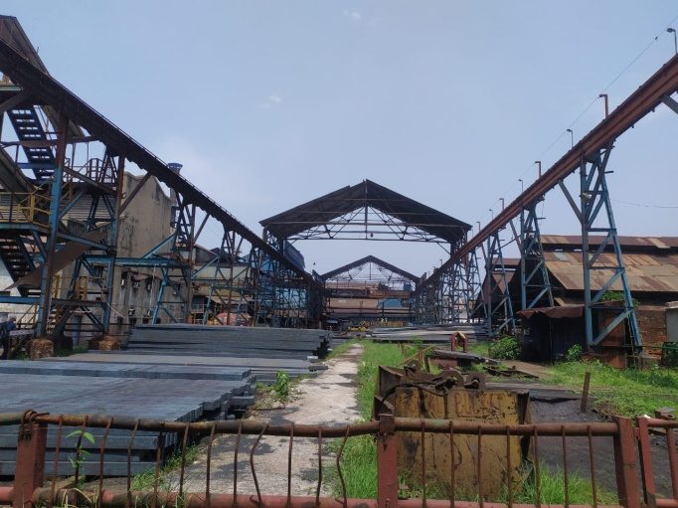
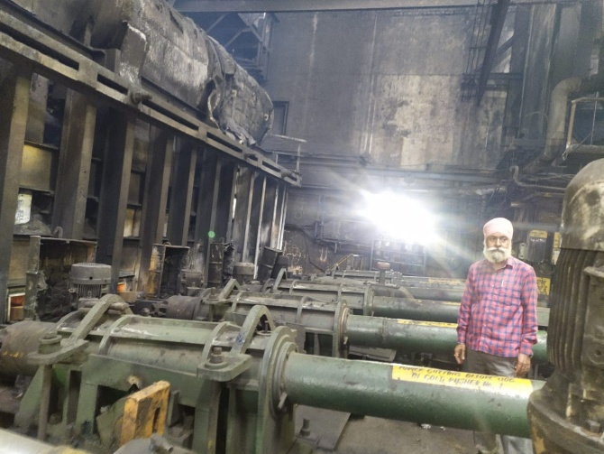
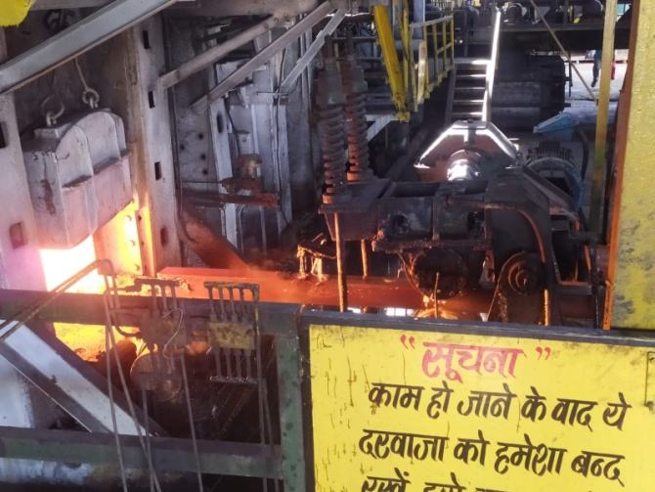
Pre-Rolling Processes:
Billet Yard: Raw material is stored here with help of cranes and placed on Billet bench.
Furnace: With the help of Cold Pusher billets are placed into furnace at temperature of 1250 to 1300 degree Celsius.
3. Hot Pusher : Pushes one Billet by each towards Stand no.1

Slide 7
Rolling Processes
Definition : Rolling is a metal forming process in which metal stock is passed through one or more pairs of rolls to reduce the thickness, to make the thickness uniform, and/or to impact a desired mechanical property. If the temperature of the metal is above its recrystallization temperature, then the process is known as hot rolling. If the temperature of the metal is below its recrystallization temperature, the process is known as cold rolling.

Slide 8
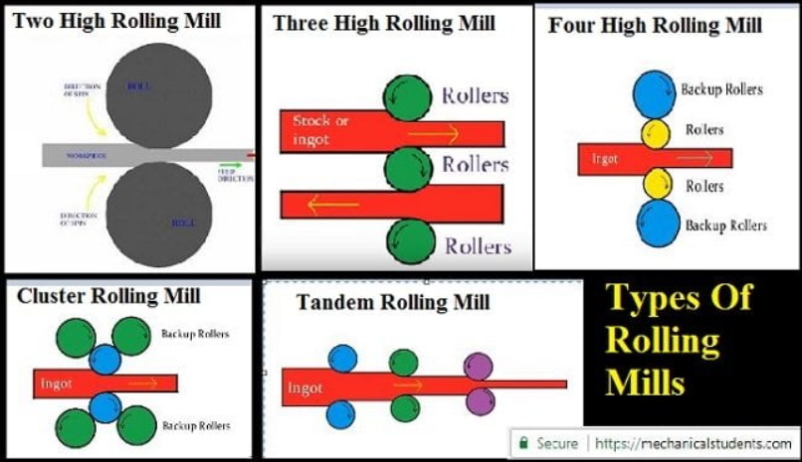
Types of Rolling Mills:
Rolling mill type in the Rod Mill Department is Tandem Rolling Mill.

Slide 9
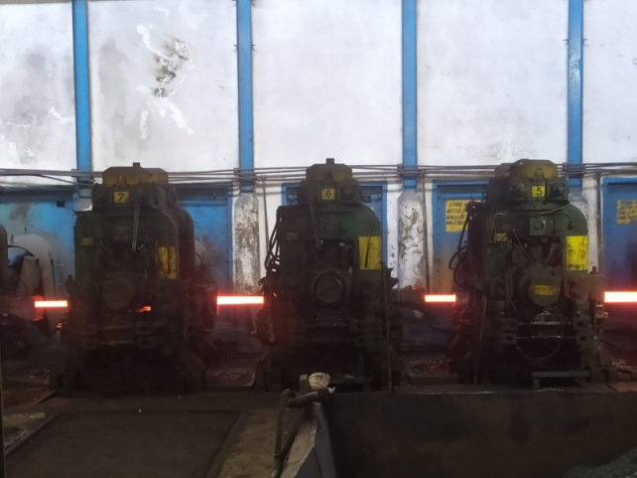
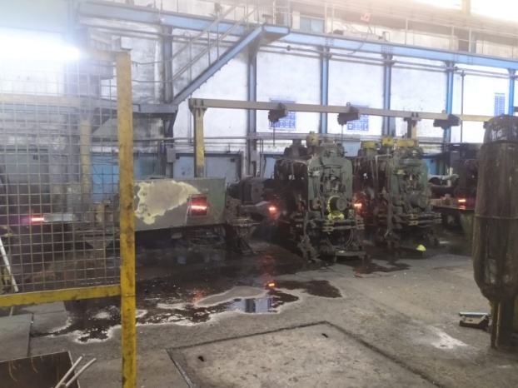
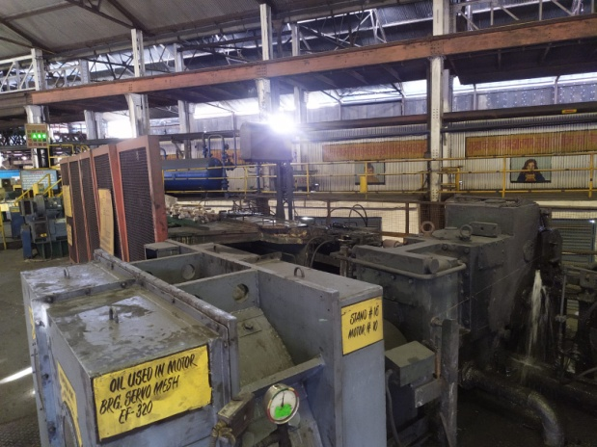
Rolling processes in rod mill
Functions
Roughing :
Roughing area mainly focuses on Reduction of the cross section area by a huge margin in order to mold the square cross section into circular it uses RTD guides.
Intermediate :
Intermediate area has lesser temperature of the processing material therefore in order to avoid the cooler ends in shear 9 it goes through head and tail cut and then a gradual decrease of diameter
NTM (Non Twisted Mill):
At this stage main focus is not on reducing the cross sectional area but on finishing of the product. Spiral gauging in Case of TMT bars.

Slide 10
Stand wise study of rollInG Processes
Important Parameters of Rolling Process
Stand No
Number of Passes
Pass Profile
Stock Size
Entry Guide
Exit Guide
Roll Size
RTD (Roller Twister Delivery Guide)
RE (Roller Entry Guide)
RF (Round Friction)

Slide 11
Stand No | Number of Passes and Pass Profile | Stock Size | Entry Guide | Exit Guide
1 | 4 Box | 90.6×146 | Friction | Friction
2 | 4 Box | 62.5×153.5 | Friction | RTD
3 | 4 Box | 85×88 | Friction | Friction
4 | 4 Oval | 58×101 | Friction | RTD
5 | 4 Round | 69×70 | RE | RF
6 | 4 Oval | 38×84 | Friction | RTD
7 | 4 Round | 55×49 | RE | RF
8 | 6 Oval | 31×69 | Friction | RTD
9 | 6 Round | 41×41 | RE | RF
10 | 8 Oval | 20.5×51 | Friction | RTD
11 | 8 Round | 29.5×30 | RE | RF
12 | 12 Oval | 16.5×38 | Friction | RTD
13 | 12 Round | 23×23.5 | RE | RF
14 | 16 Oval | 15×28 | Friction | RTD
15 | 16 Round | 18.9×19.7 | RE | RF

Slide 12
Stand No | Number of Passes and Pass Profile | Stock Size | Entry Guide | Exit Guide
16 | 2 Oval | 10.7x20 | Fixed Guide | Nozzle
17 | 2 Round | 13.7 | 820 A/1 | Nozzle
18 | 2 Oval | 8.7x16 | Fixed Guide | Nozzle
19 | 2 Round | 11.1 | 820 A | Nozzle
20 | 2 Oval | 6.7x14 | Fixed Guide | Nozzle
21 | 2 Round | 8.9 | 820 A | Nozzle
22 | 2 Oval | 5.5x11 | Fixed Guide | Nozzle
23 | 2 Round | 7.2 | 820 A | Nozzle
24 | 2 Oval | 4.4x8.2 | Fixed Guide | Nozzle
25 | 4 Round | 5x57 | 820 A | Nozzle

Slide 13
Yield Improvement and Scrap Reduction Methodology
Identifying Yield Losses in Total
-Sources of Yield Loss
-Reasons of yield Loss
-Material and capital lost due to it
-Suggestions for Yield Improvement
Identifying Sources of Scrap
-To know the reasons for Scrap production
-To find and suggest methods for Scrap
reduction

Slide 14
Yield Loss | Source
1) Scales | Furnace, Stands
2) Cobble | Roughing, Intermediate, NTM , Roller table
3) Head and Tail end Crop | Shear 9 , Shear 15
4) Uncooled Losses (TMT) | Water box
5) Billet Bending | Billet Yard
6) Rust Losses in Storage | Storage Yards
7) Wrong Product | NTM , Roller table, Decoiling unit
8) Finished Goods Losses | Decoiling Mill

Slide 15
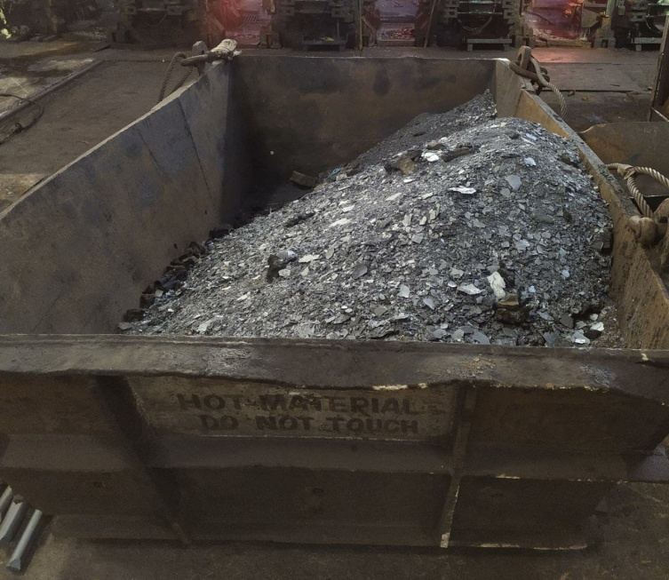
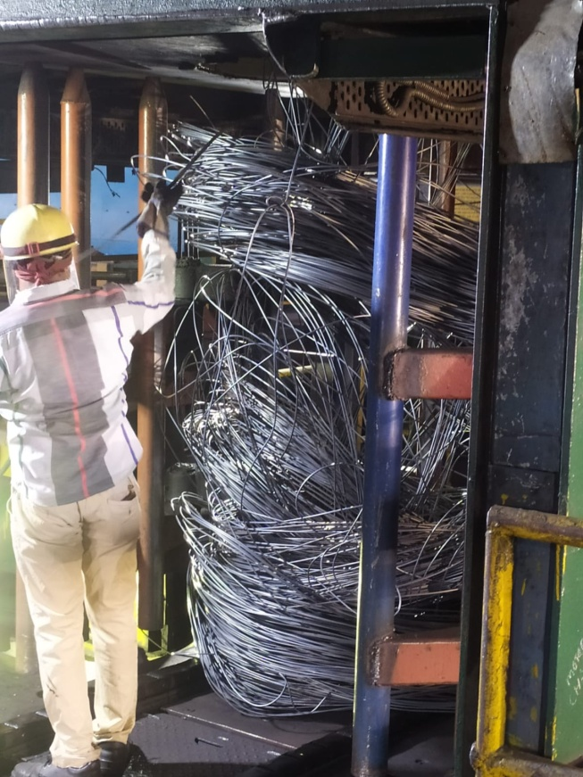
Reasons for the Yield Losses
Scales :
Oxidation of the hot billets due air contact of metal at high temperature.
Cobble :
*Roughing and Intermediate :
- Breakdown due to not proper selfing
- Guides not aligned properly (manual mistake)
- Roll Bearings , Roll selfing , Roll Gauging ( Not proper equipment)
- Equipment damage due to Cold metal
*Roller Table (Jamming) :
- Roller Table Hooking
- Motor Tripping 0 to 17 no motor
- Bad Quality of Metal
- Laying of Coil in Oval Shape

Slide 16
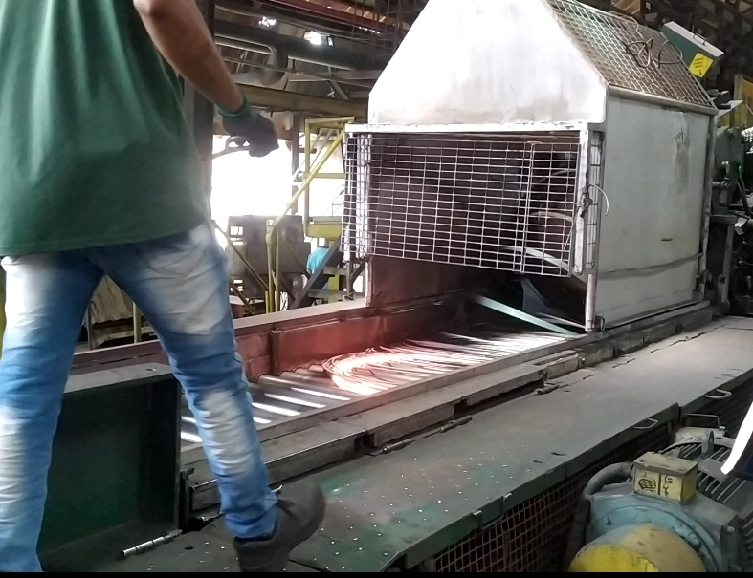
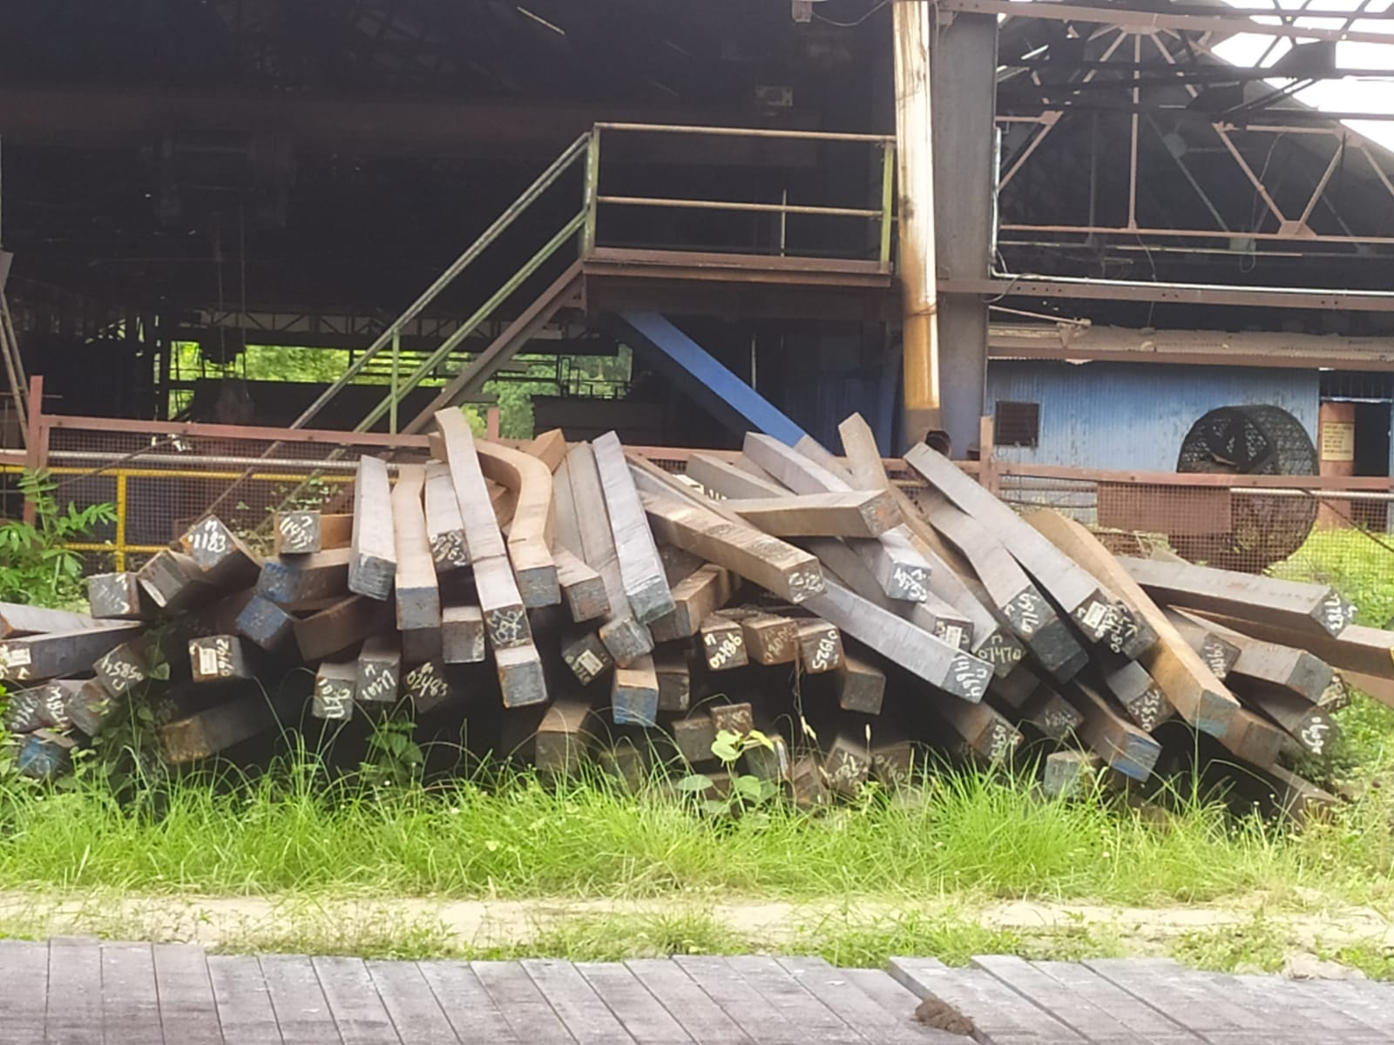
Shear 9 , Shear 15 :
To Avoid the cooled and non uniform ends which can bring complications for
further rolling.
4. Uncooled Losses in TMT:
There is time lag inside the waterbox between water flow and material passing therefore a length of material remains uncooled and hence not having the quality required for TMT rods.
Billet Bending:
While shifting Billets from loaded trucks to Ground or to the Billet Bench due to power tripping and failure in the electromagnet. Billets are straightened by use of hydraulic press , which delays the process and eventually the process.

Slide 17
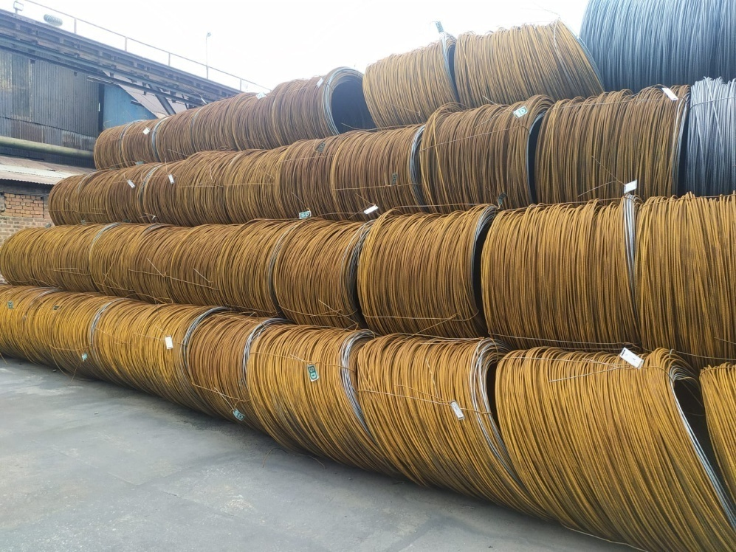
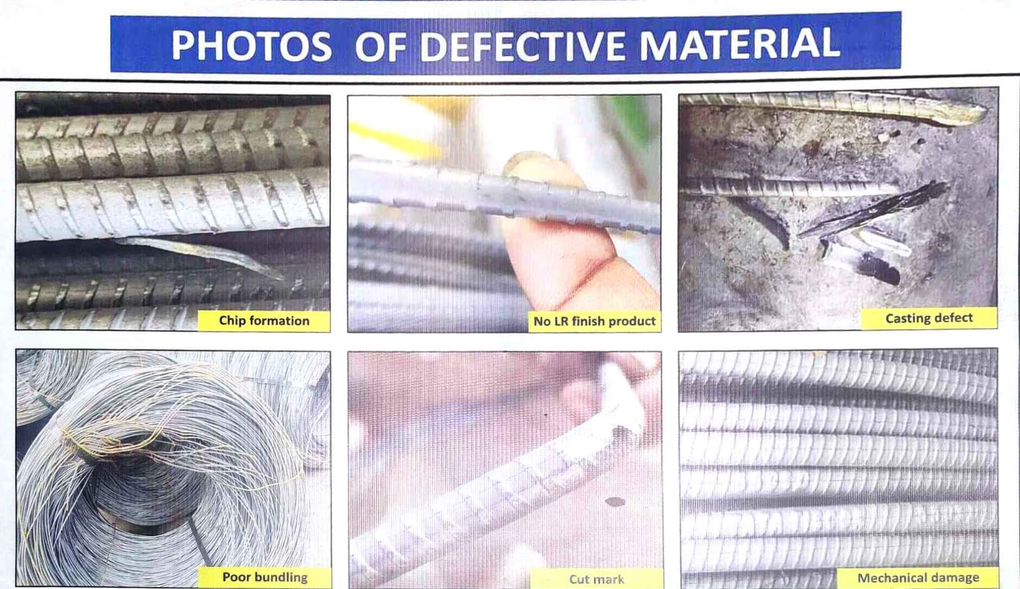
Rust Losses in Storage:
When Coils are shifted by the Cranes and kept for storage. Due to not proper protection from atmosphere and storage facilities many coils are scrapped due to rust.
Wrong Product:
If the produced product doesn’t match the quality demanded then it is due to raw material problems or due to defect in processing
8. Finished Goods Losses:
During Decoiling of the Coils there is scrap left behind in some quantities as all TMT bars are cut in length of 12 m and also some length of coil is lost to testing.

Slide 18
Yield Loss Calculation per Billet
Weight of one Billet = 1.170 tonnes
Weight of the Finished Products per Billet/Per Coil
8 mm Coil Weight per metre = 380-390 gm/m
6 mm Coil Weight per metre = 210-220 gm/m
5.5 mm Coil Weight = 1.140 tonnes

Slide 19
Losses For 8mm TMT bars
For 1 Section of 8mm
No of Billets Rolled = 14001
No of Cobble = 16
Production in Tonnes : 15540 tonnes
Weight of Scrap at Shear 9 per billet = 8 kg
Weight of Scrap at Shear 15 per billet = 2.5 kg
Weight of Scales produced in Processing(lost material) = 12 kg
Weight of Uncooled Rings at Decoiling Mill = 15 front and 1 back ring = 16 rings
1 ring = 3 m : 16 x 3 x 385gm = 18.48 kg
Weight of Scales produced in Decoiling Mill = 0.11 kg
Weight of FG per billet = 1.122 tonnes
Yield loss Percentage Calculation = (1170- 1109.9) x 100/1170 = 4.096%
Total Yield = 100 – 4.096 = 95.904%

Slide 20
Losses for 6mm TMT bars
For 1 Section of 6mm
No of Billets Rolled = 1741
No of Cobble =9
Production in Tonnes : 1933 tonnes
Weight of Scrap at Shear 9 per billet = 8 kg
Weight of Scrap at Shear 15 per billet = 2.5 kg
Weight of Scales produced in Processing(lost material) = 12 kg
Weight of Uncooled Rings at Decoiling Mill = 16 front and 2 back ring = 18 rings
1 ring = 3 m : 18 x 3 x 215 gm = 11.61 kg
Weight of Scales produced in Decoiling Mill = 0.11 kg
Weight of FG per billet = 1.1103 tonnes
Yield loss Percentage Calculation = (1170 – 1110.3) x 100/1170 = 5.104 %
Total Yield = 100 – 5.104 = 94.896 %

Slide 21
Losses for 5.5 mm Wires
For 1 Section of 5.5mm
No of Billets Rolled = 4737
No of Cobble =13
Production in Tonnes : 5257 tonnes
Weight of Scrap at Shear 9 per billet = 8 kg
Weight of Scrap at Shear 15 per billet = 2.5 kg
Weight of Scrap Produced at Roller table
Weight of Scales produced in Processing(lost material)
Weight of FG per billet = 1.14 tonnes
Yield loss Percentage Calculation =(1170 – 1140) x 100/1170 = 2.564%
Total Yield = 100 – 2.564 = 97.435%

Slide 22
Production Rate
For May 2022
Total production 22730 tonnes
Total Coils = 20480 (cobble not included)

Slide 23
Suggested Remedies for the Yield Losses and Scrap Reduction
Scales Reduction:
Cobble:
Shear 9 , 15
Water Box Losses reduction
Billet Bending
Rust losses
Wrong Product
Finished Good Losses

Slide 24
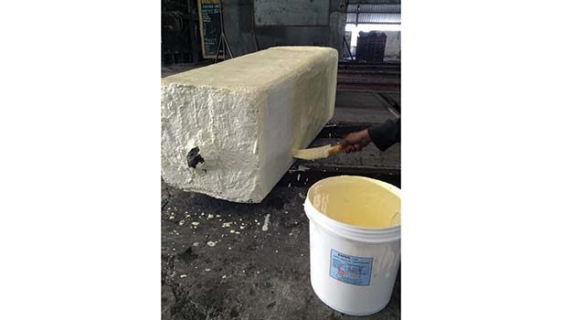
Scales Reduction
Protective Coatings Increase Material Yield and Reduce Costs
Burning Loss Due to Oxidation
O₂ + 2 Fe ↔ 2 FeO
O₂ + 4 FeO ↔ 2 Fe₂O₃
CO₂ + Fe ↔ CO + FeO
CO₂ + 3 FeO ↔ Fe₃O₄ + CO
Characteristics of Protective Coating and its Use
An anti-scale coating is applied on billets/ingots to be heated before charging them into the furnace.
Acts as a barrier between the metal and oxygen. Before heating, care is taken to apply a uniform, impervious coating on the billet to be heated.
Heat transfer from the heating medium to the metal unaffected by the coating, which also reduces decarburization on billets during hot-rolling operations.
No reaction with the steel surface; no release of toxic fumes during use, hot forging or storage; and it is otherwise nonhazardous.

Slide 25
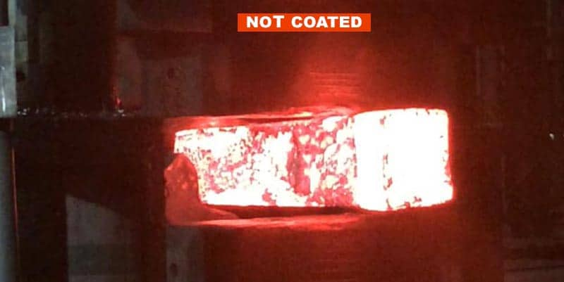
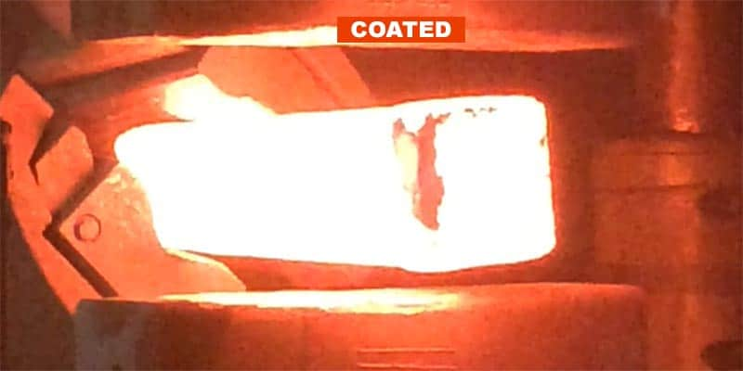
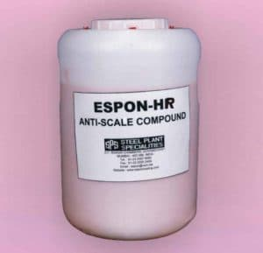
Protective Coating Increases Yield
• Total reduction in scale = 0.95 mm
• Percentage reduction in material loss due to mill scale by using anti-scale coating = 56.98%
• Approximately a 70% reduction in mill scale is achieved by anti-scale coating in hot rolling of stainless steel.
• Scale loss of 2.14 kg was observed on billets without coating.
• Scale loss of 1.140 kg was observed on billets with a double layer of protective anti-scale coating.
• Percentage reduction in mill scale loss due to use of protective anti-scale coating = 47.00%
Add source

Slide 26
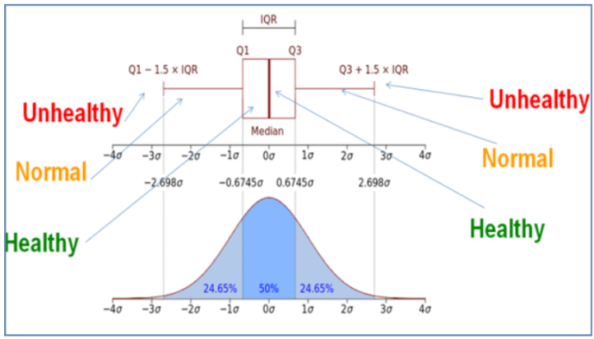
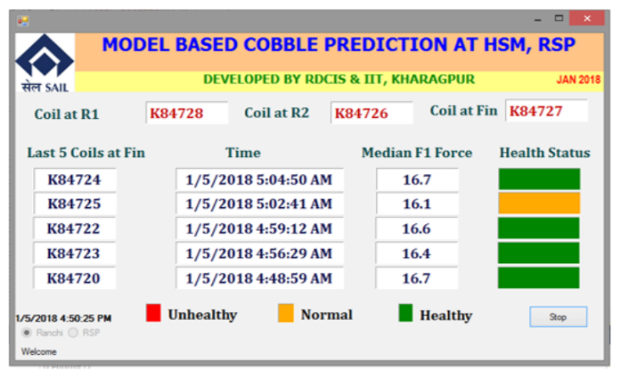
Cobble
Design of Modified Side Guide System
Add description
Signal Analysis of Finishing Mill Parameters
Study of Process Parameters

Slide 27
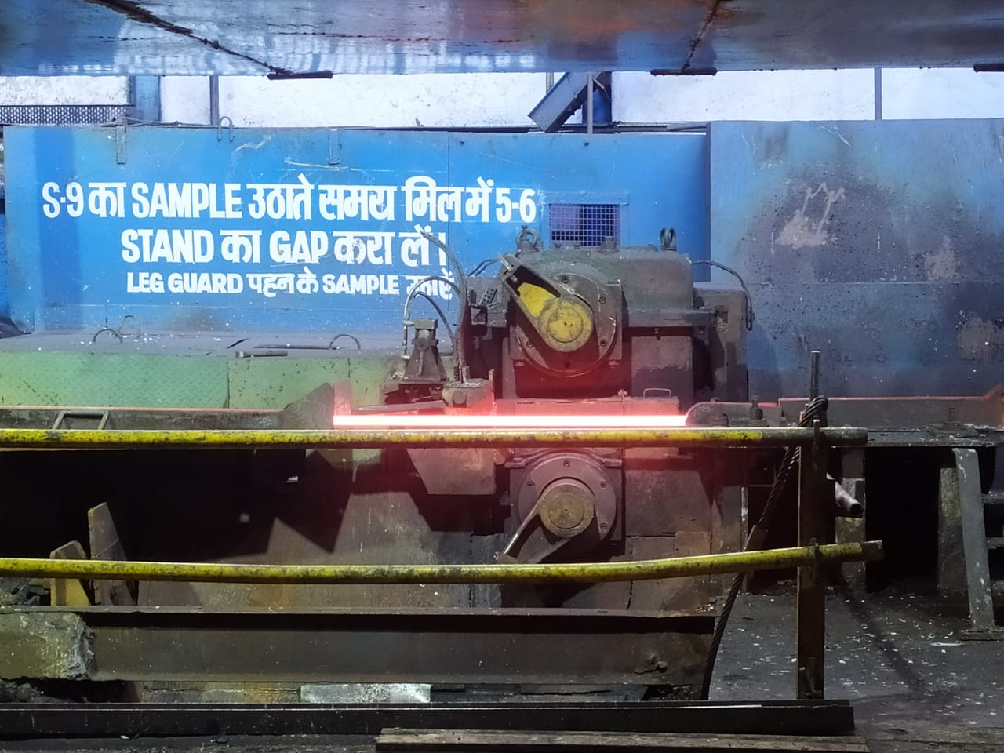
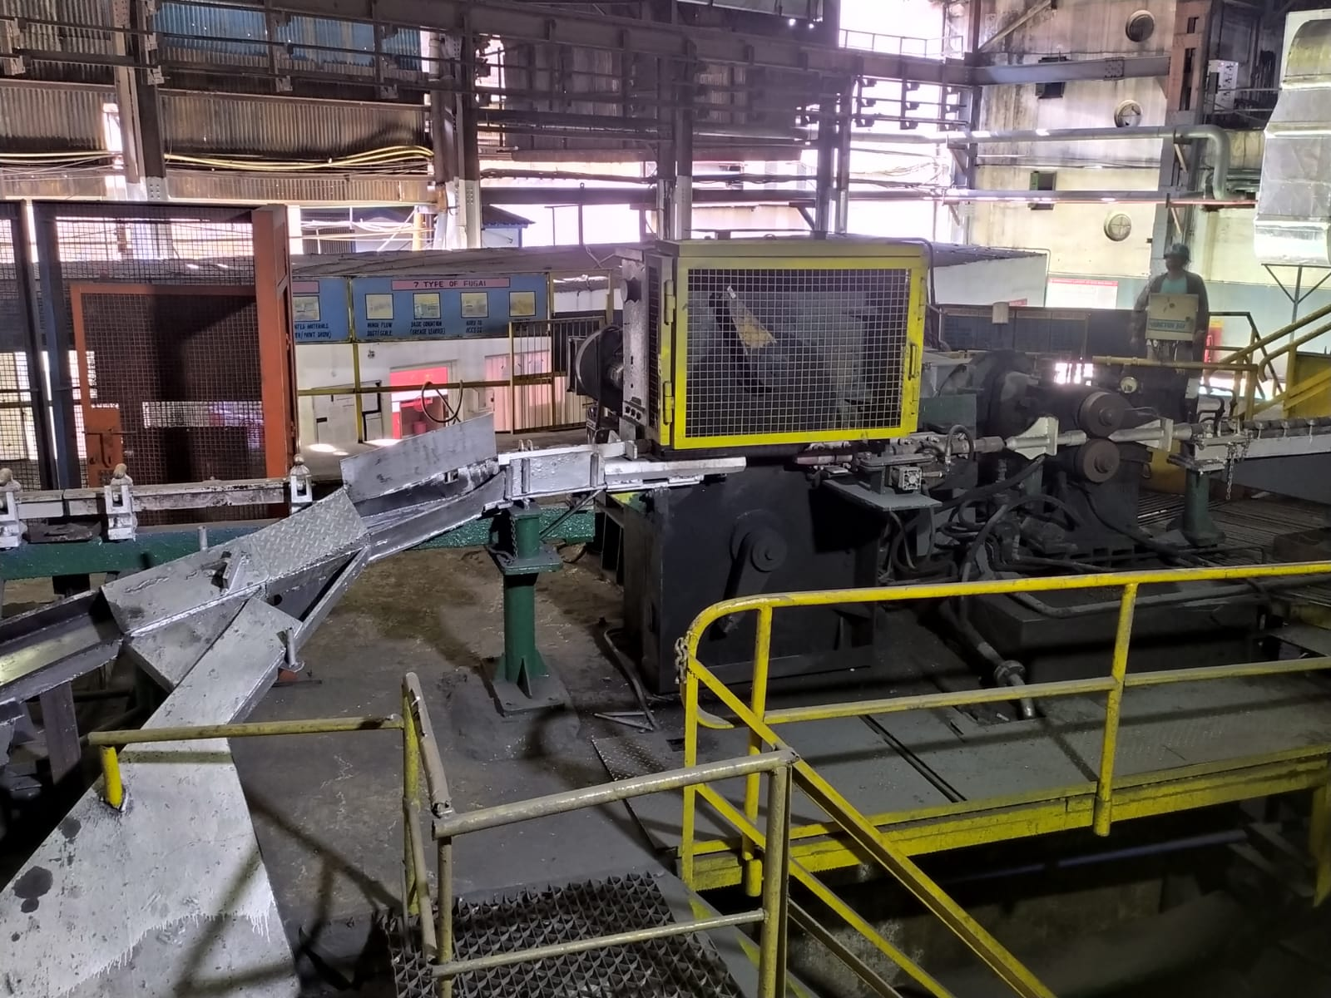
Shear 9 , 15
Only fractured part of Head and Tail must be removed by the Operator
Currently Shear15 cuts length of 1.5 m instead of 0.75 m
Regular maintenance of the Operating systems and sensors.
Implementation of Machine learning programmes for accurate results
Shear-9 Shear-15

Slide 28
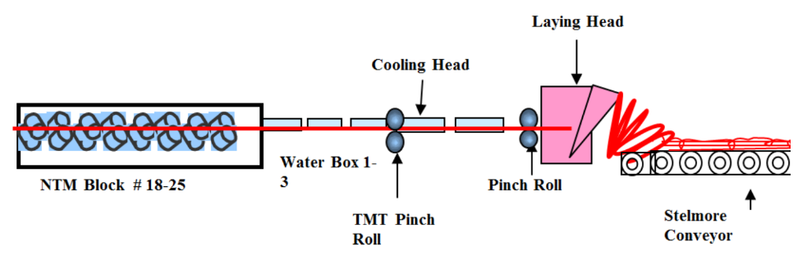
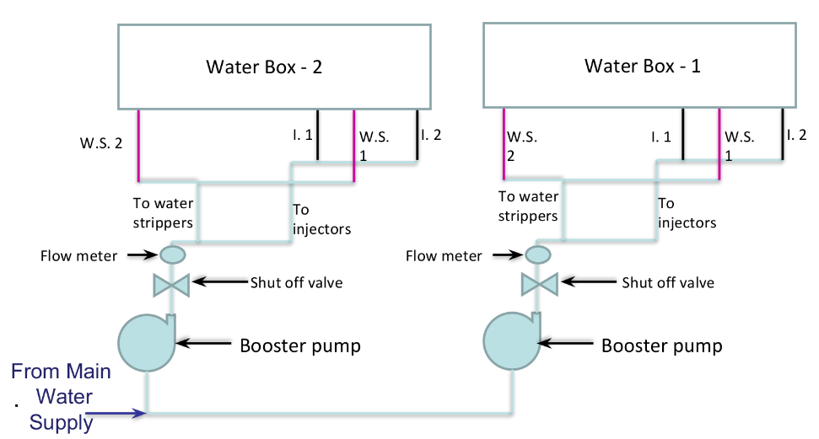
Water Box Losses eduction
Separate water supply systems for each water boxes, as shown in line diagram below

Slide 29
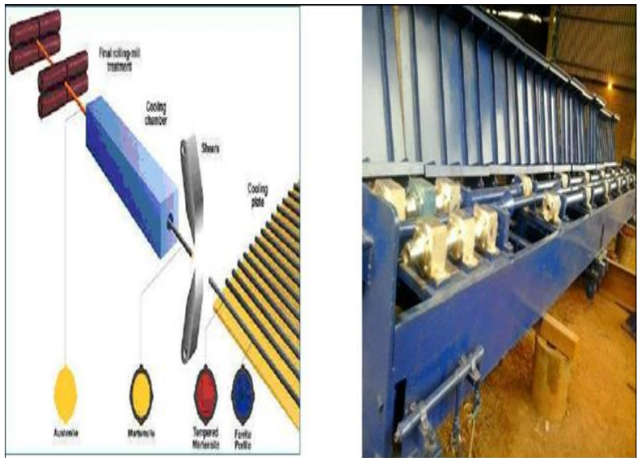
Replacement of Coiling System with Straight Bar System
It will avoid the extra efforts for the Decoiling Mill
It will minimize the losses due to uncooled rings as it will become easy for segregation of uncooled material.
Once segregated, initial uncooled part can be cooled manually.

Slide 30
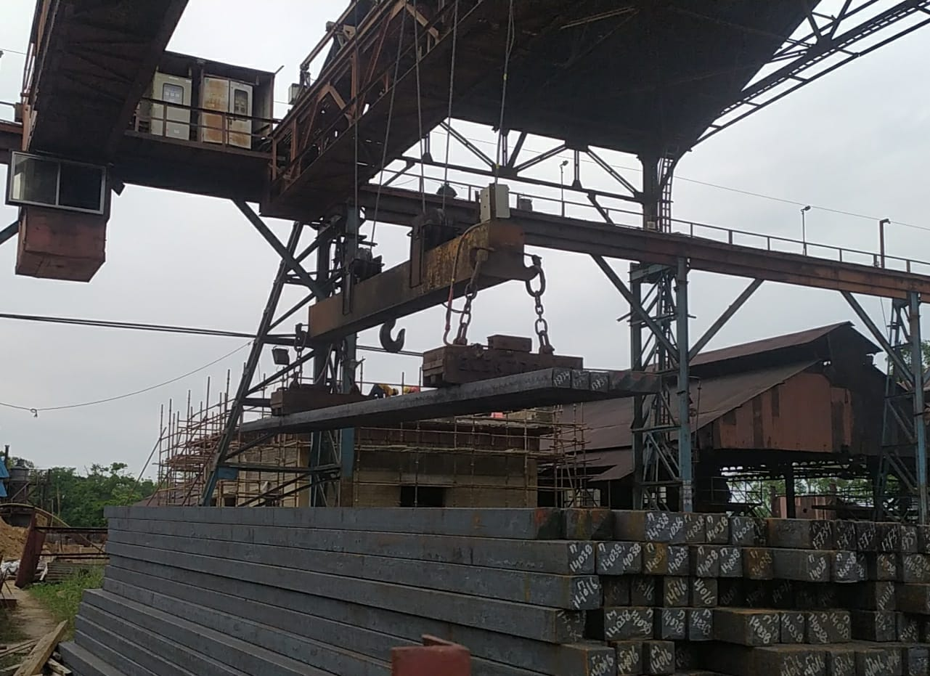
Billet Bending
Avoiding Power Trip in the Billet yard area

Slide 31
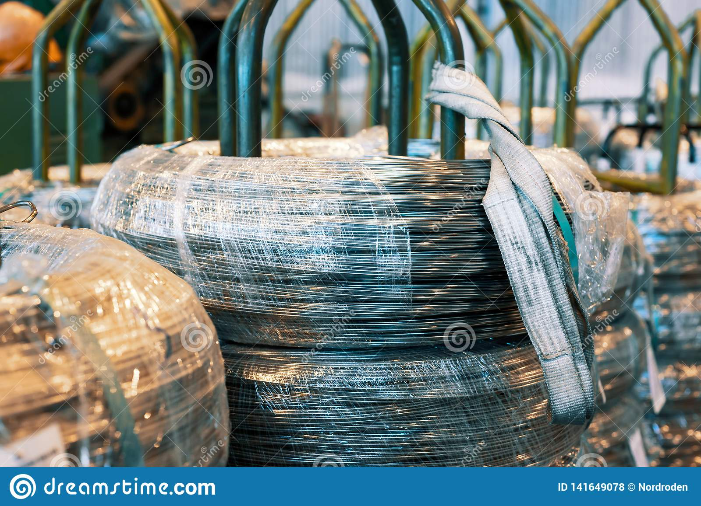
Rust losses
Development of the Warehouses
Develop ways to for Rust resistance of FG

Slide 32
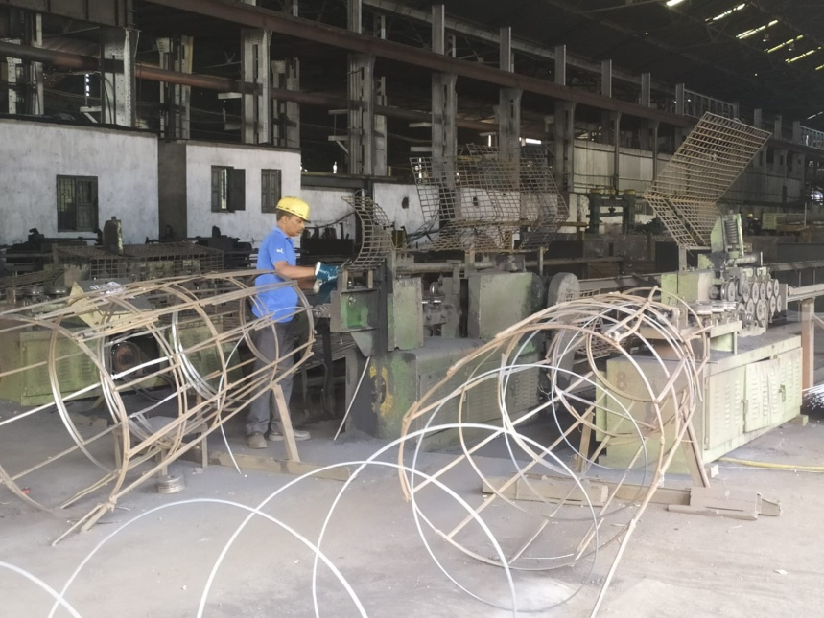
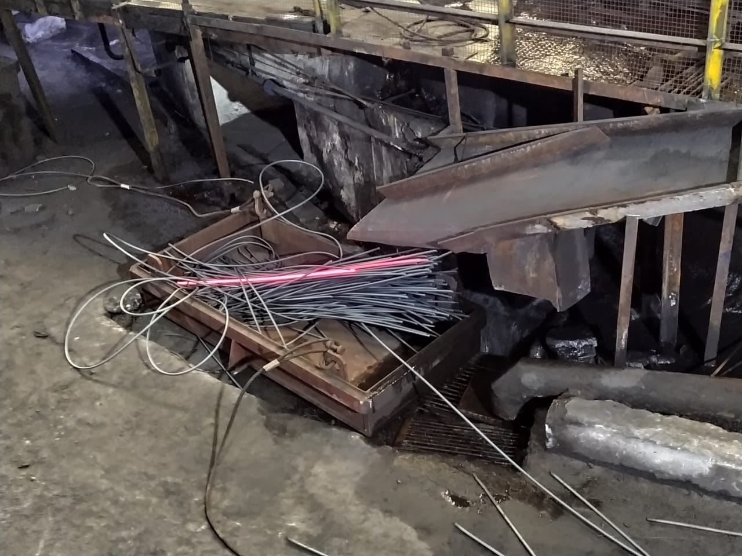
Finished Good Losses
Shear 9 and 15 cutting length
In order to Avoid FG losses for TMT bars length of Coil can be adjusted to obtain just at multiple of 12 metres
Billet size = 130 x 130 x 9 m
Stock size at S9 = 41 x 41 weight removed=8 kg(61.86cm)
Stock size at S15 = 18.9 x 19.7 weight removed=2.5 kg(87.3cm)

Slide 33
Results
Yield obtained per Billet
22730 x 100/ (20480 x 1.170)= 94.86%
Yield loss per Billet = 100- 94.86= 5.14%
Capital loss behind a Billet and Finished Good
5.14/100 x 23,229.35 Rs = 1193.96 Rs
Monthly Losses Due to Cobble
= 38 x 23,229.35 = 8,82,715.3 Rs

Slide 34
Conclusion
The production of the Company is pretty much impressive and demanded by market for its quality and brand but with the new tools and technologies at hand it is necessary for such firm to introduce new automation methods in the operating sector rather than dependence on the manual operating. Eg, machine learning
For the machining part flexibility of the process needs to be much more than its present condition in order for the company to be sustainable according to the future.
At present there is much less scope for the testing part of any process at the company for any new changes. This issue needs to be resolved by developing some simulation methods Eg, Ansys . Or else with the help of some model based testing.
Data collection at various departments regarding Raw material , Production , Failures should be widely increased for the purpose of proper analysis.
Only three types of products are manufactured in Rod mill department when it has potential to increase a lot making process flexible and decreasing the time for section change.

